Slide 1
Course Registration Database Design
Kung Fu Tea
Wenhui Yang, Jing Zhang, Zheng Guo, Shuting Dai

Slide 2
Objectives
To provide a platform for students to search and register the courses.
To provide a platform for universities to manage the course registration, and the professor allocation.
To help the university analyze the capacity of each course.
To track information of each student’s taken courses and currently taking courses, calculate and record his/her degree process.
To show the detail of courses like course description to students clearly.

Slide 3
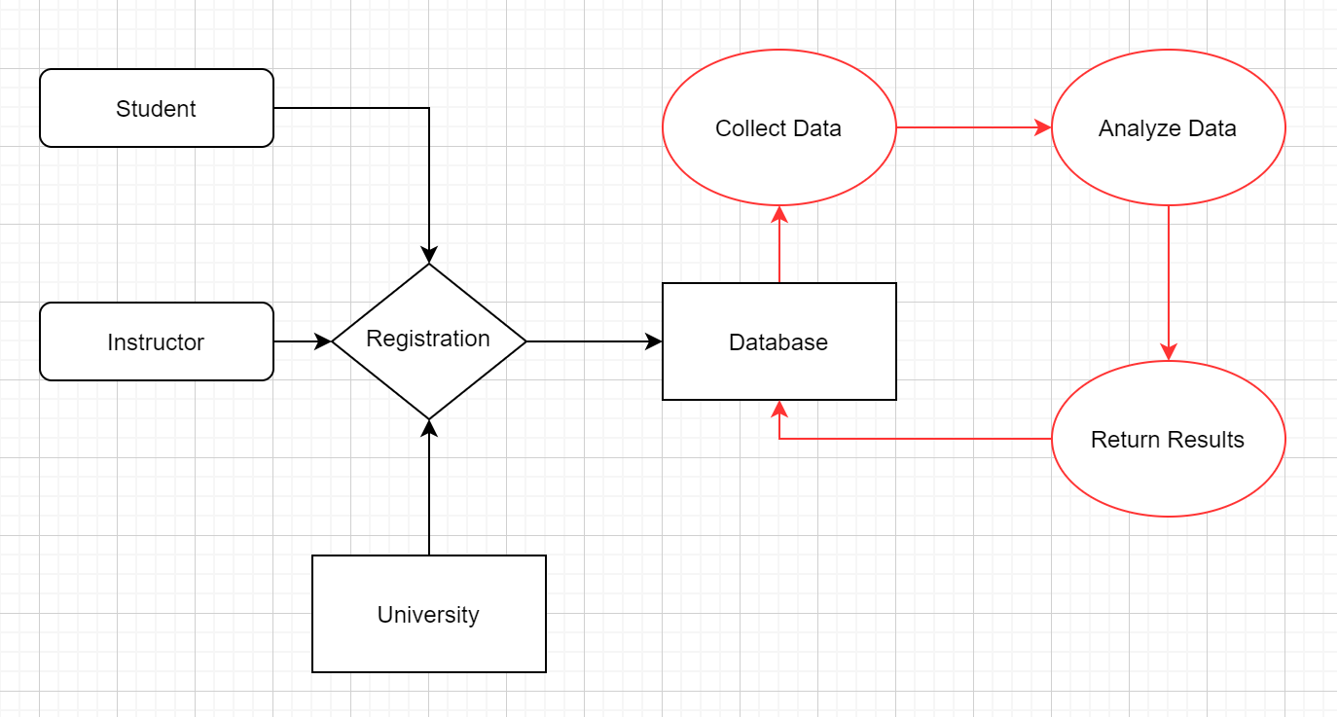
High Level Design

Slide 4
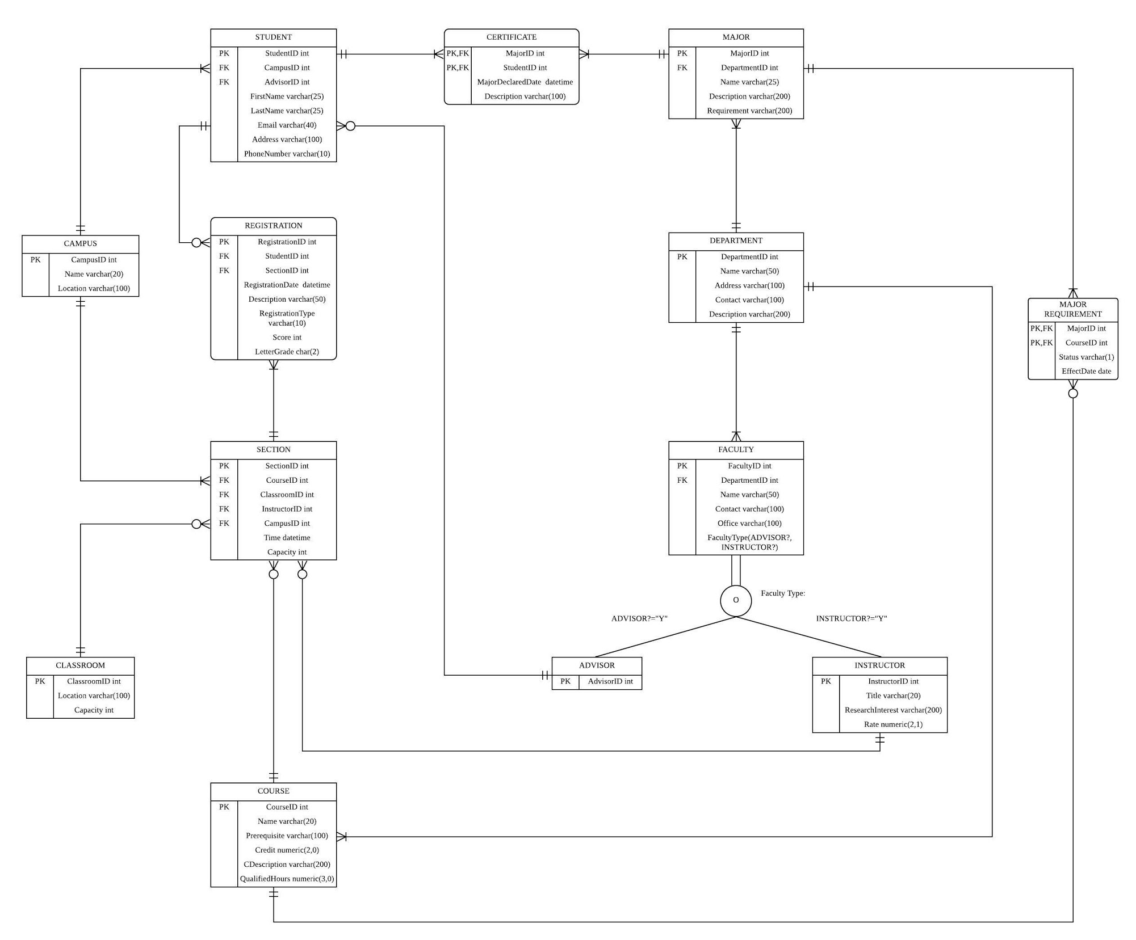
Final ER Diagram

Slide 5
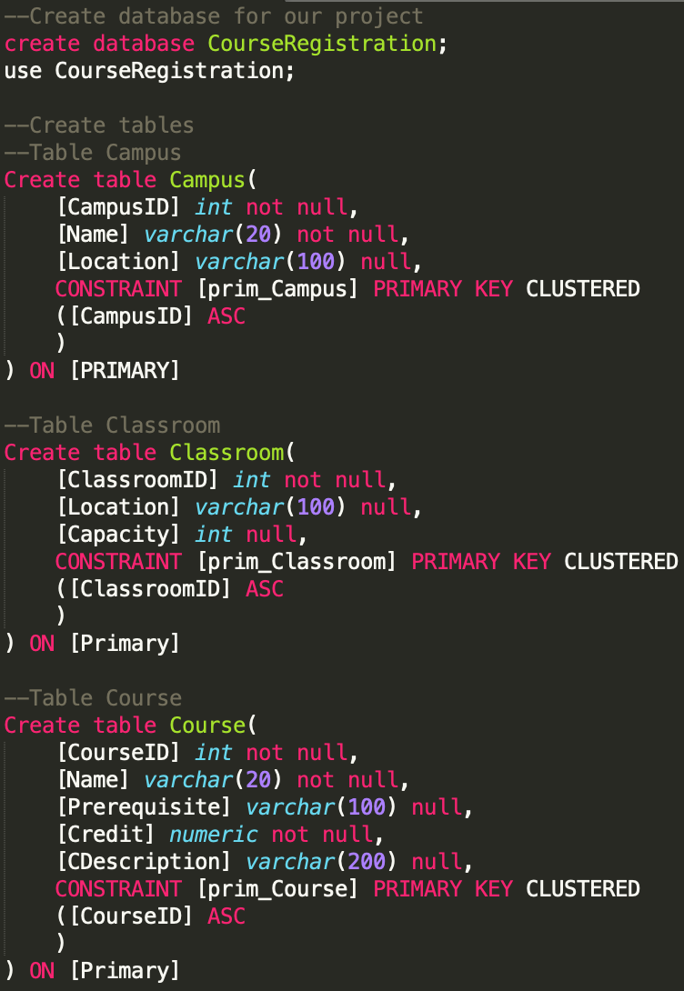
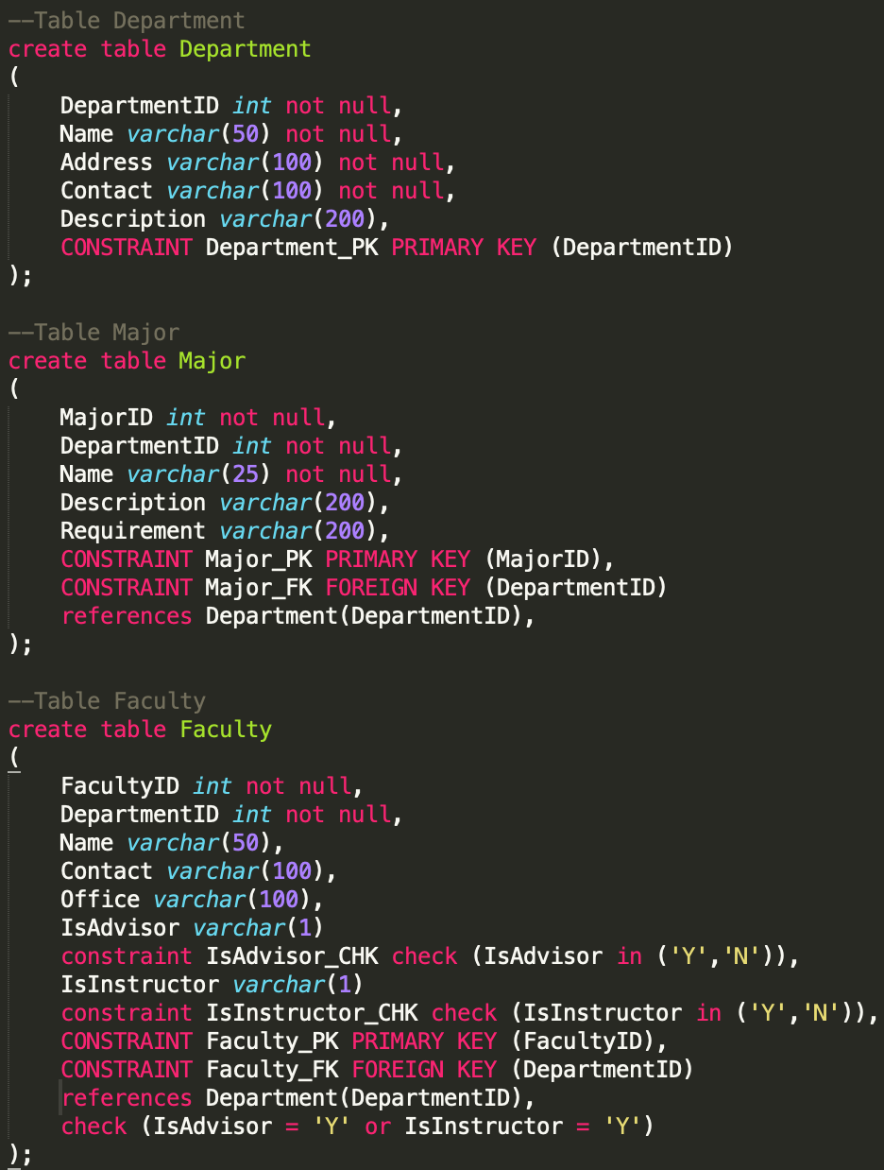
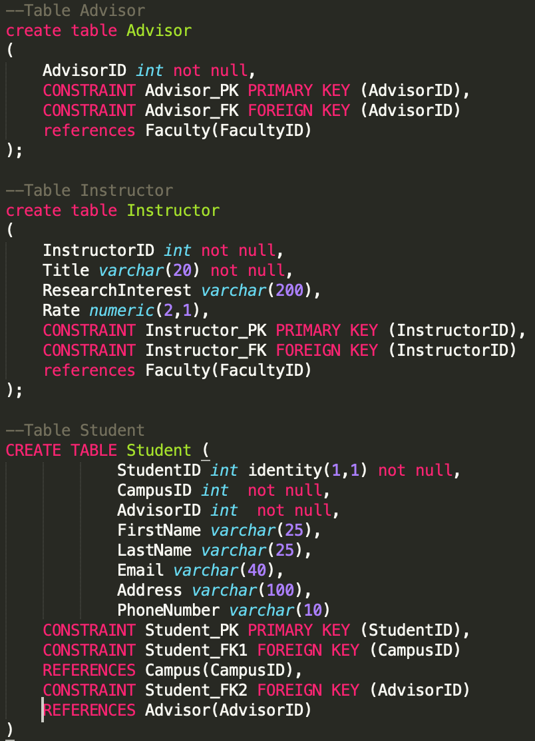
Database Objects -- DDL

Slide 6
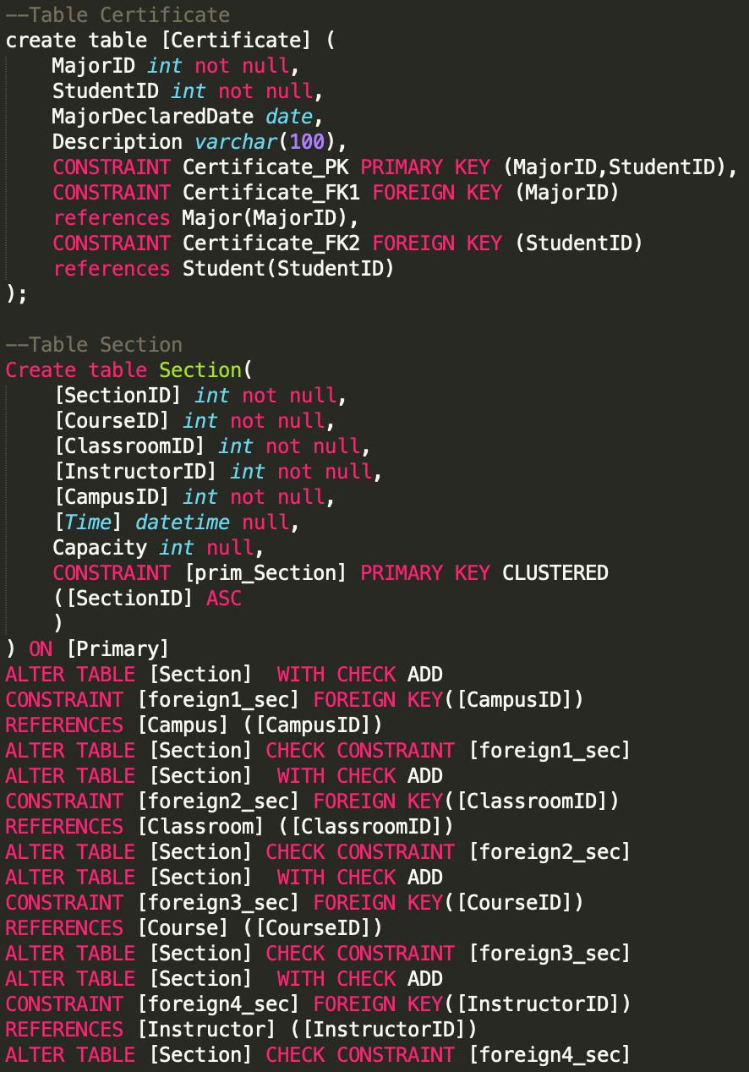
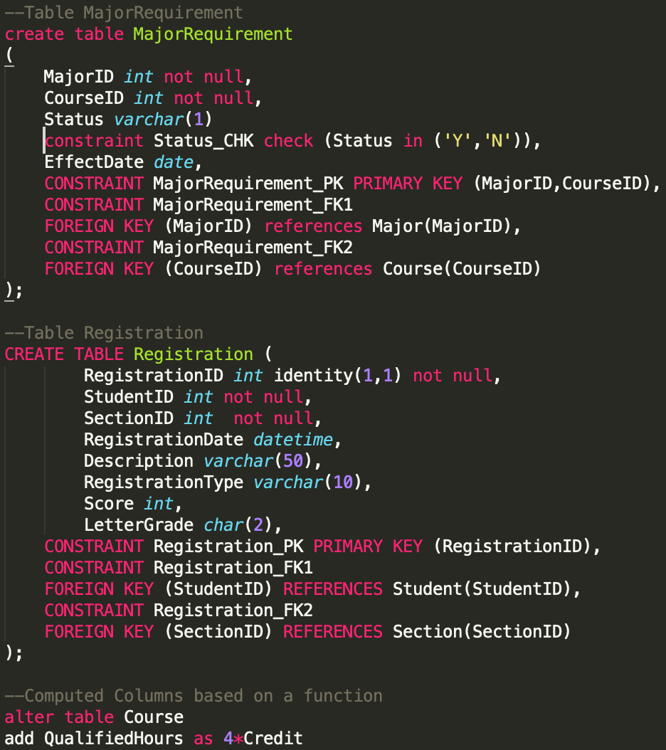
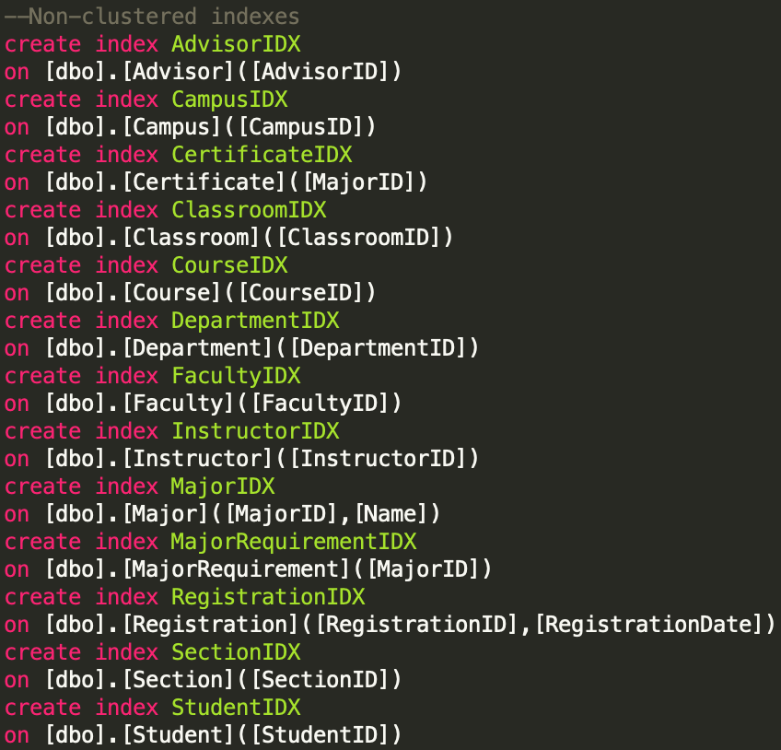
Database Objects -- DDL(cont’d)

Slide 7
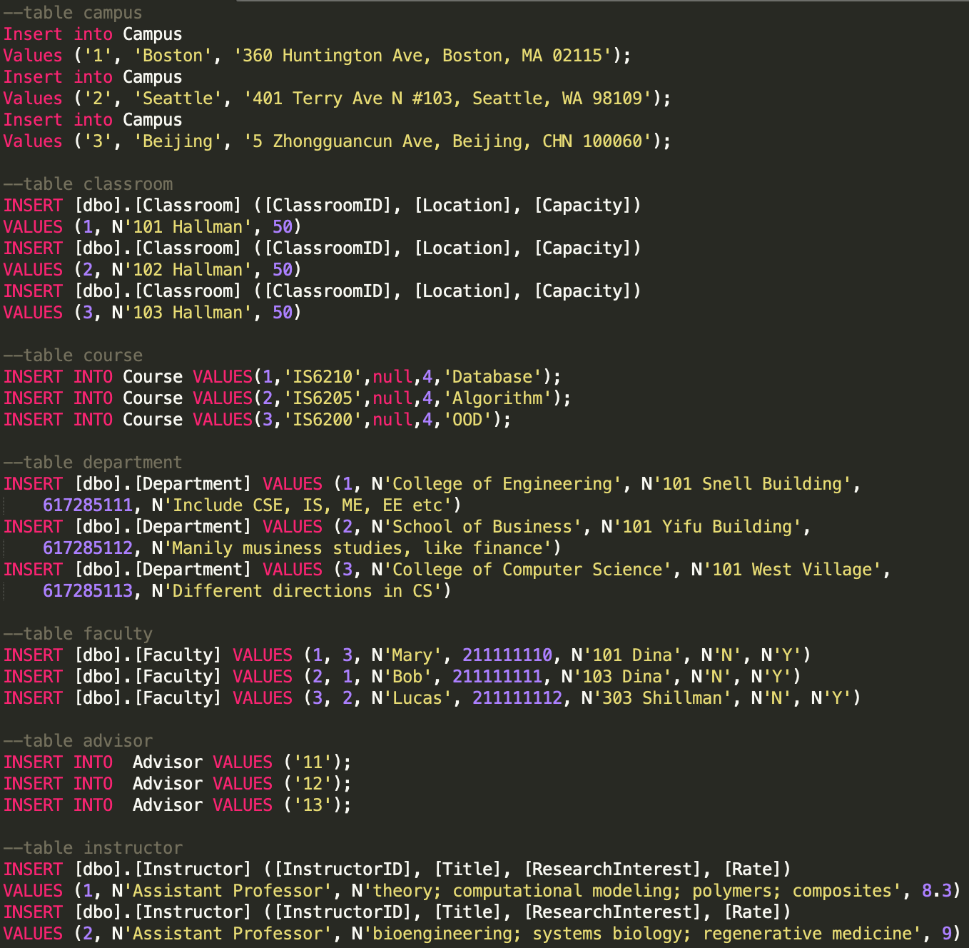
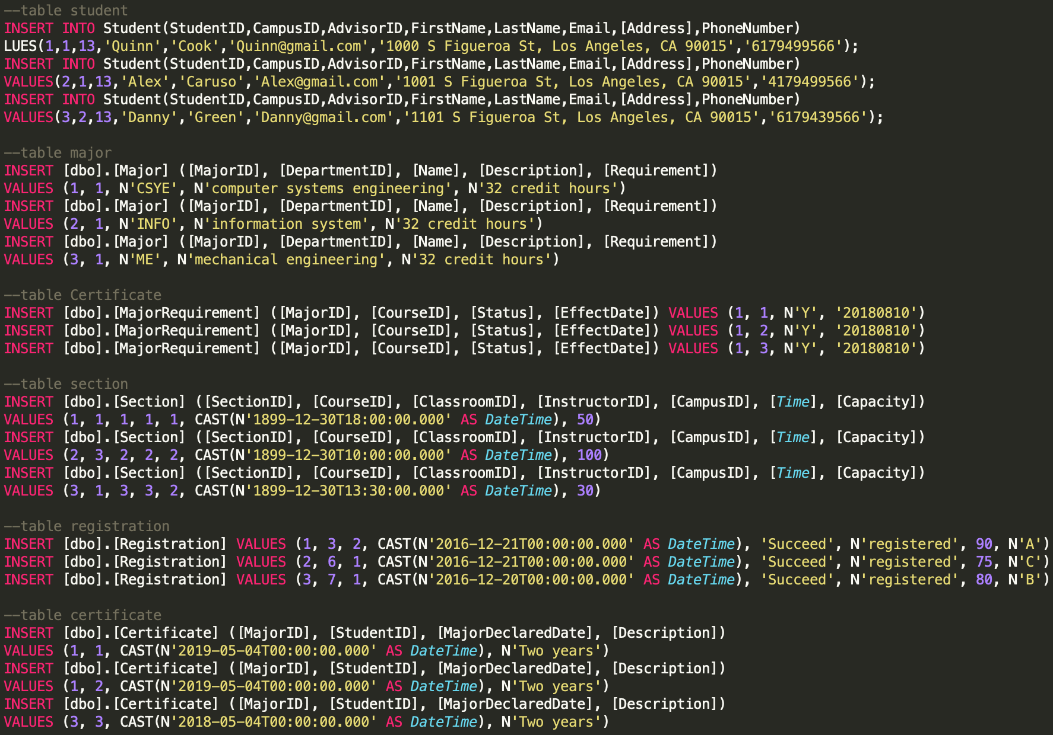
Data Population--part of INSERT scripts

Slide 8
Database Objects -- Stored Procedures
We created five stored procedures.
GetStudentsInCampus -- get the number of students in given campus
GetStudentRegisteredCourse -- check the students who registered given course
GetMinMajorDeclaredDate -- check the earliest date to declare certificate to students
GetSpecificStudent -- get the information of student based on given studentID
GetCurrentRegistration -- get the total credits of the current registration of the specific student.

Slide 9
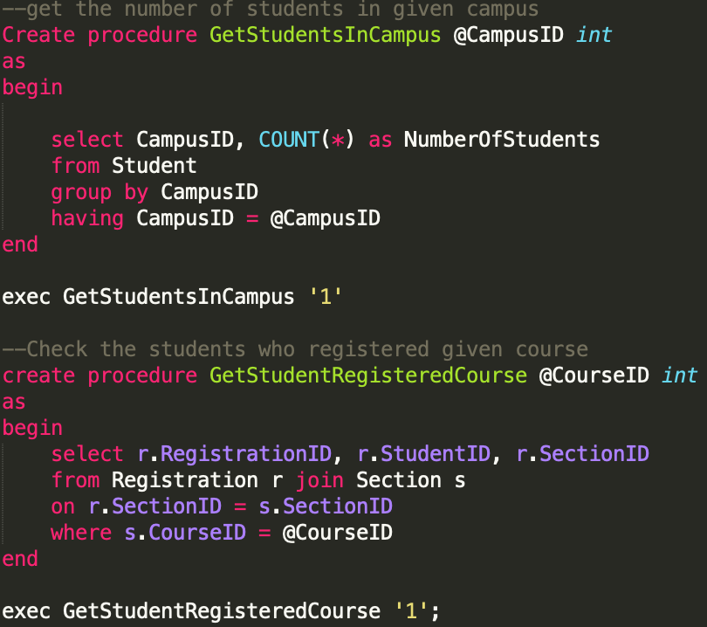
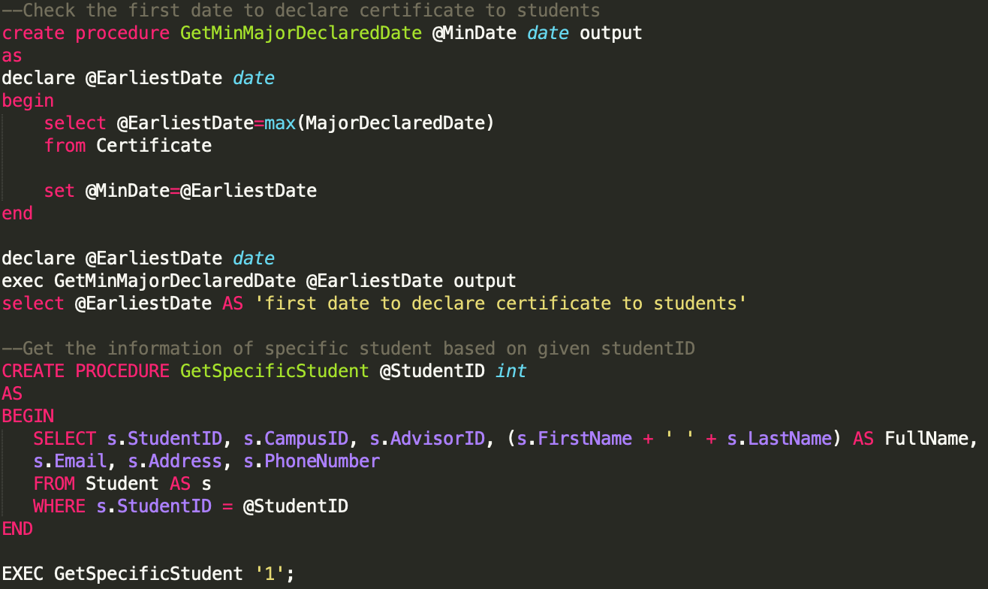
Database Objects -- Stored Procedures(cont’d)

Slide 10
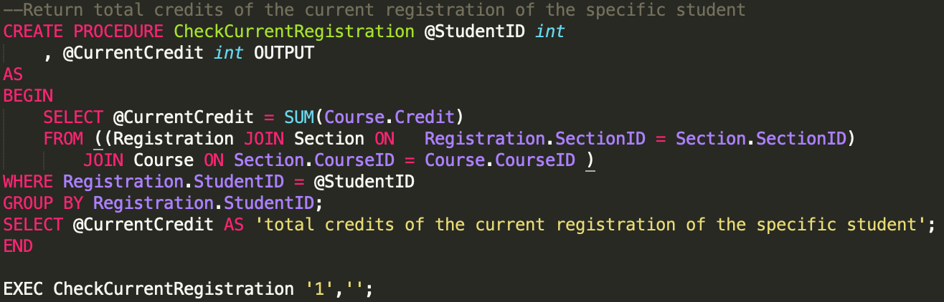
Database Objects -- Stored Procedures(cont’d)

Slide 11
Database Objects -- Views
StudentRegisteredCourse View
Check those students who have registered courses
GetRegisterationByCampus
Get the students’ registration information in Boston campus
RegisteredCourseInformation
Check the instructors who teach the registered course

Slide 12
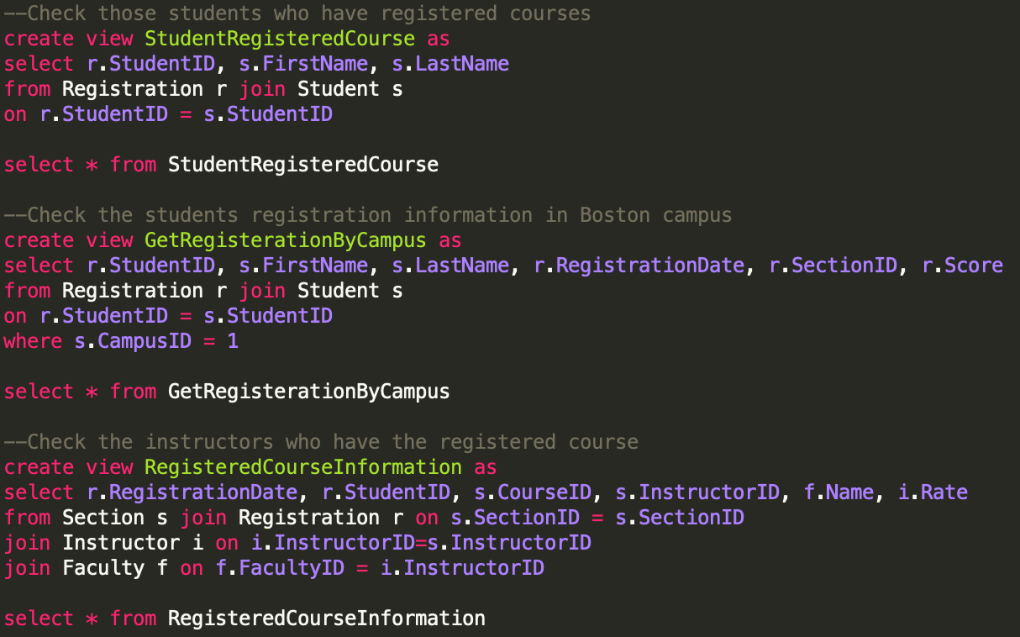
Database Objects -- Views(cont’d)

Slide 13
Database Objects -- Triggers
RegistrationHistory Trigger
Record the registration information before update, first we create a table then we create trigger, update the registration table and check the trigger operates successfully
StudentRegistration Trigger
When a student successfully registers a class, the capacity of its section will decrease by 1. And when capacity drops to zero, the registration for that section will be closed.

Slide 14
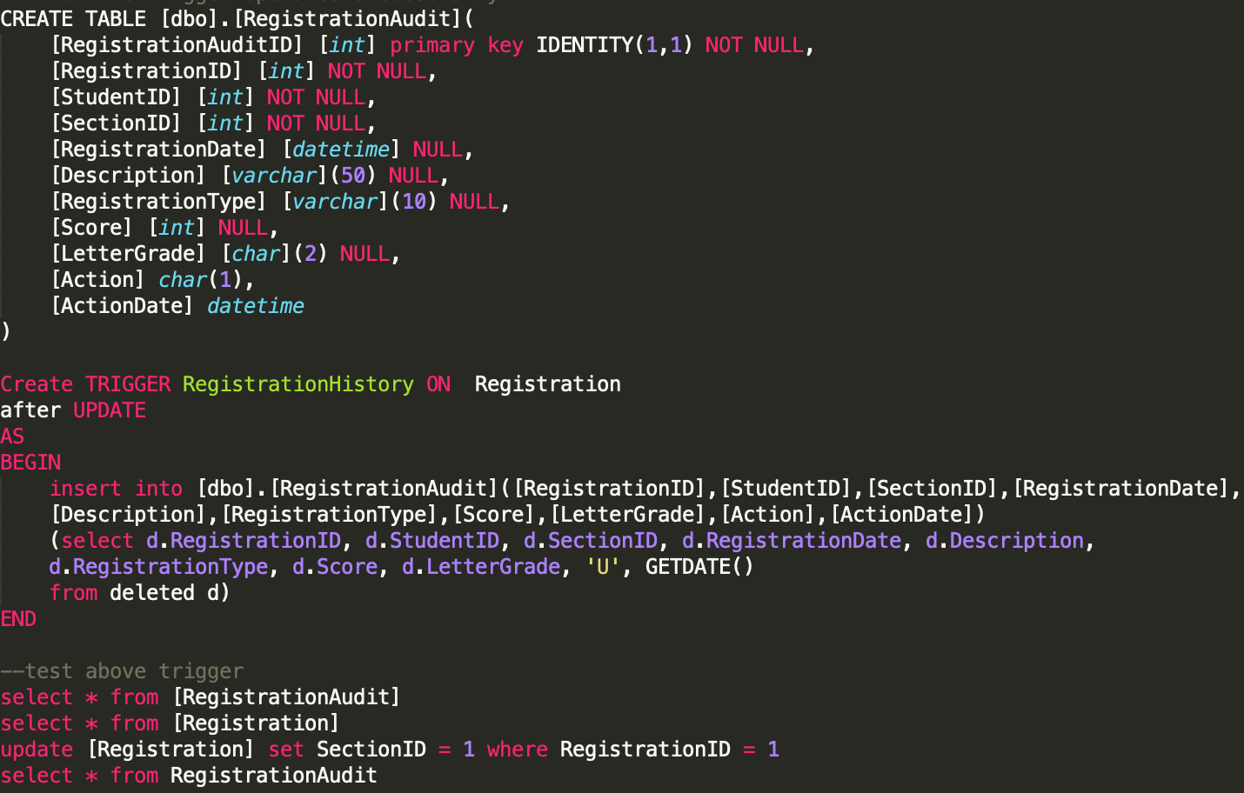
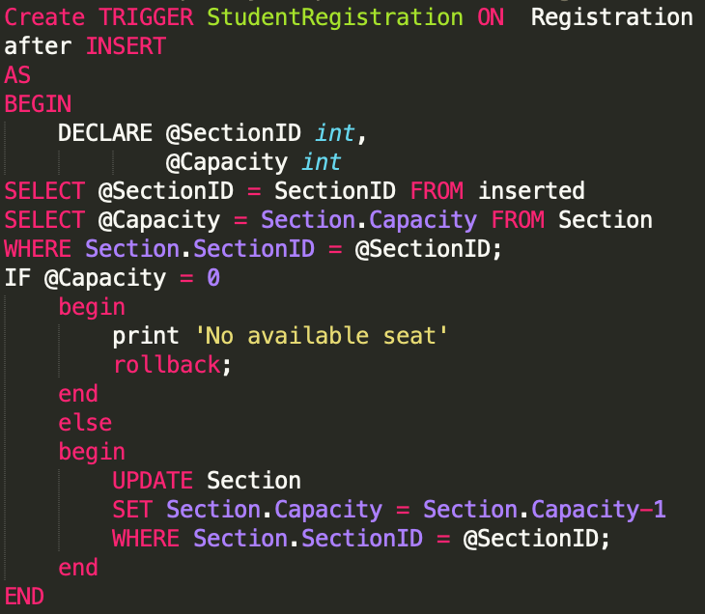
Database Objects -- Triggers(cont’d)

Slide 15
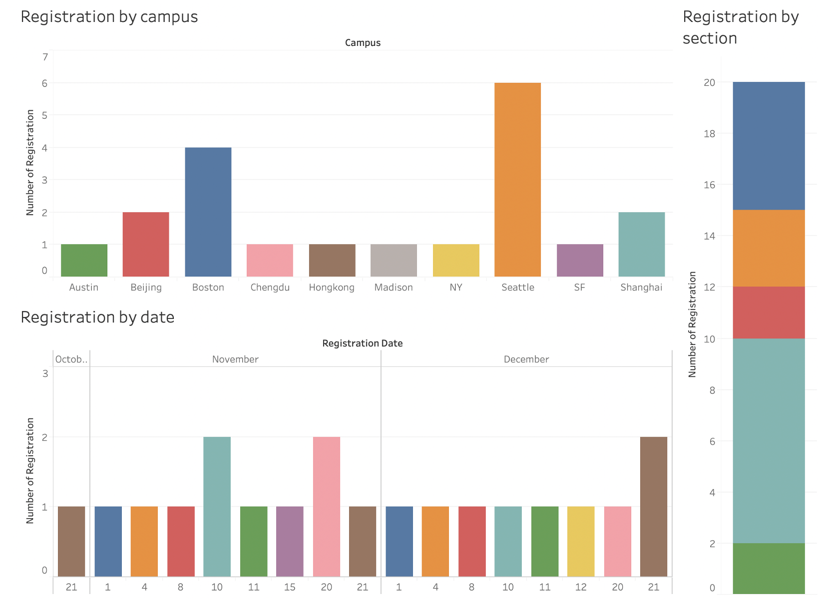
Dashboard/Reports

Slide 16
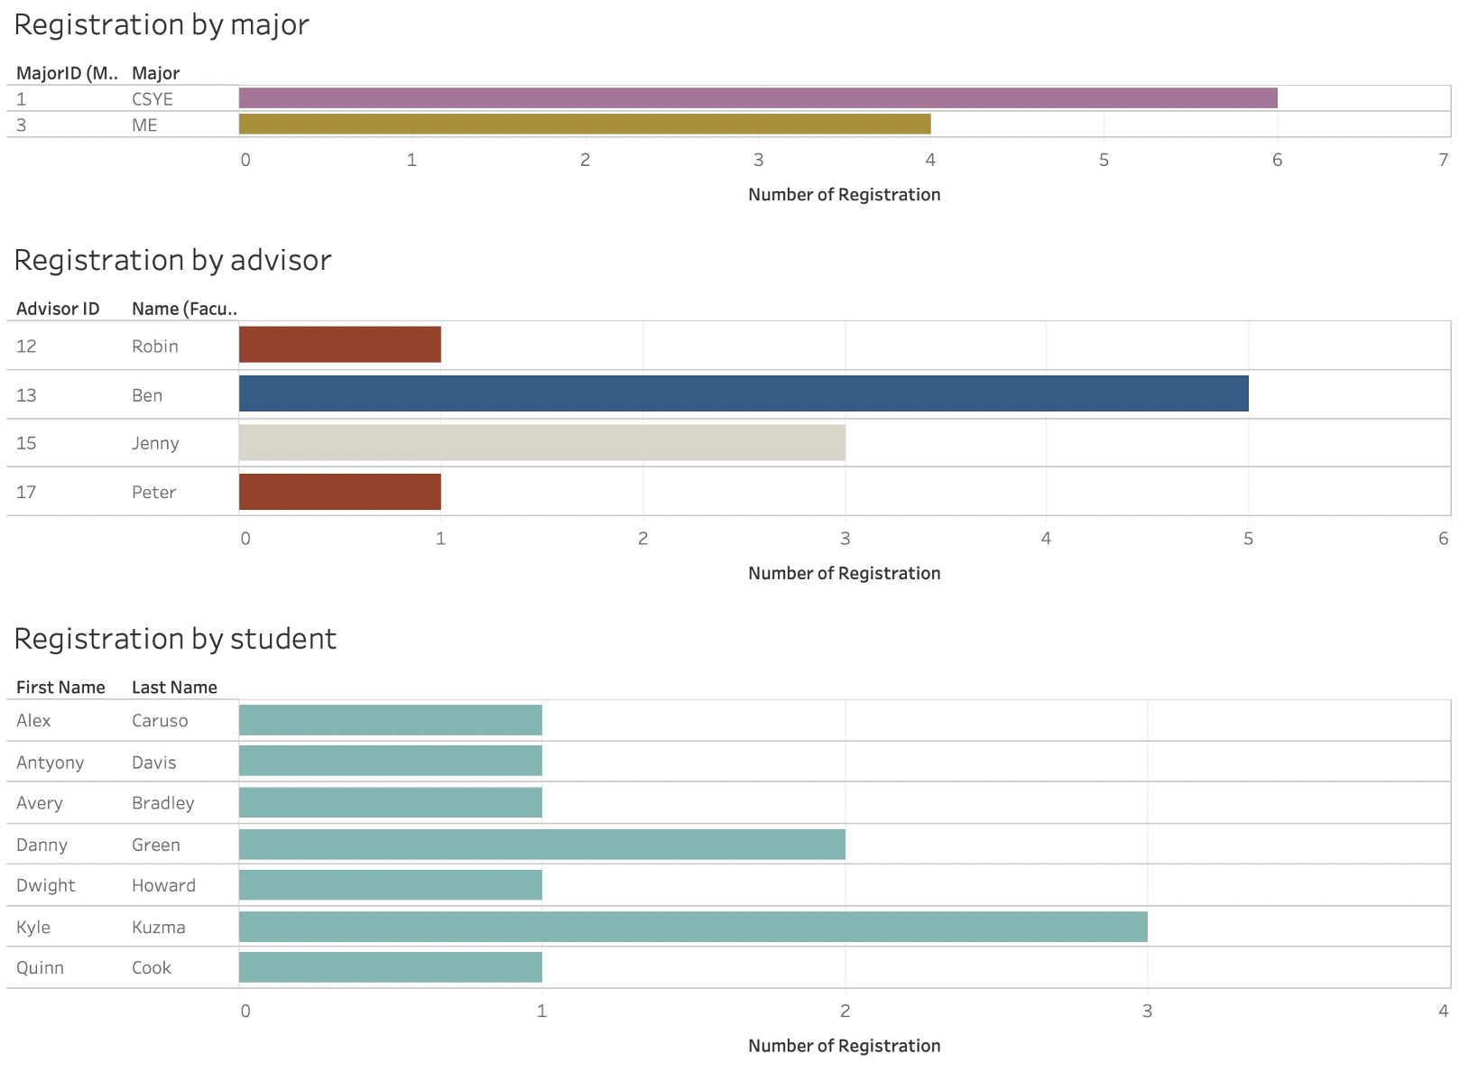
Dashboard/Reports

Slide 17
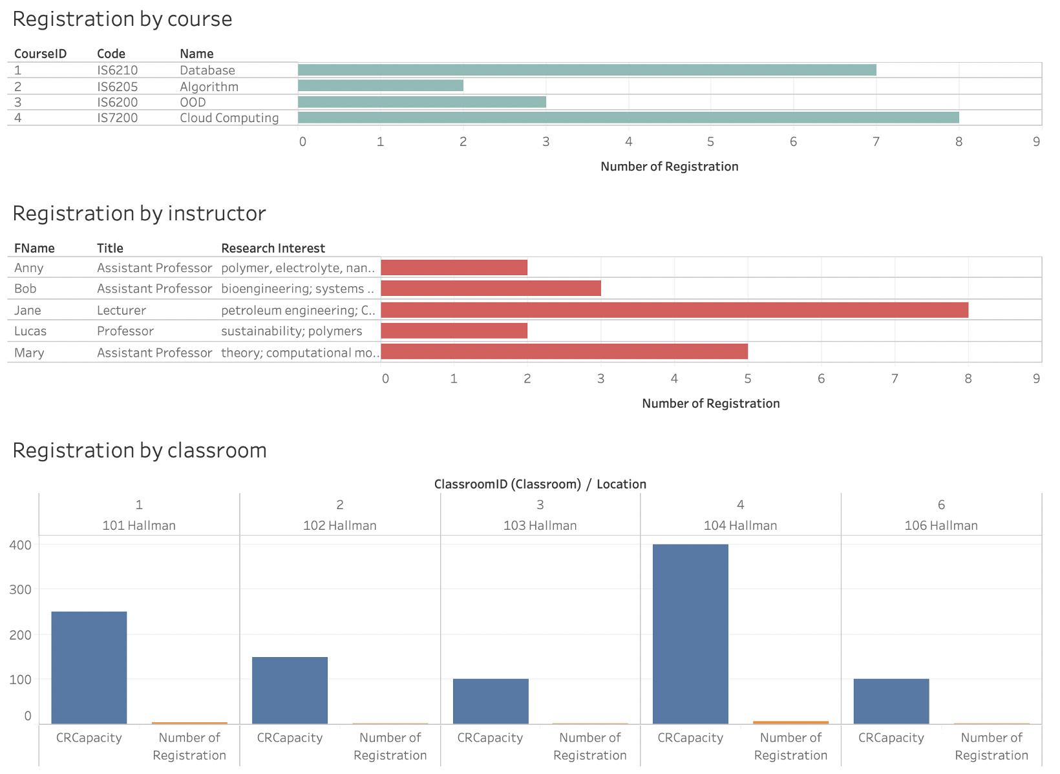
Dashboard/Reports

Slide 18
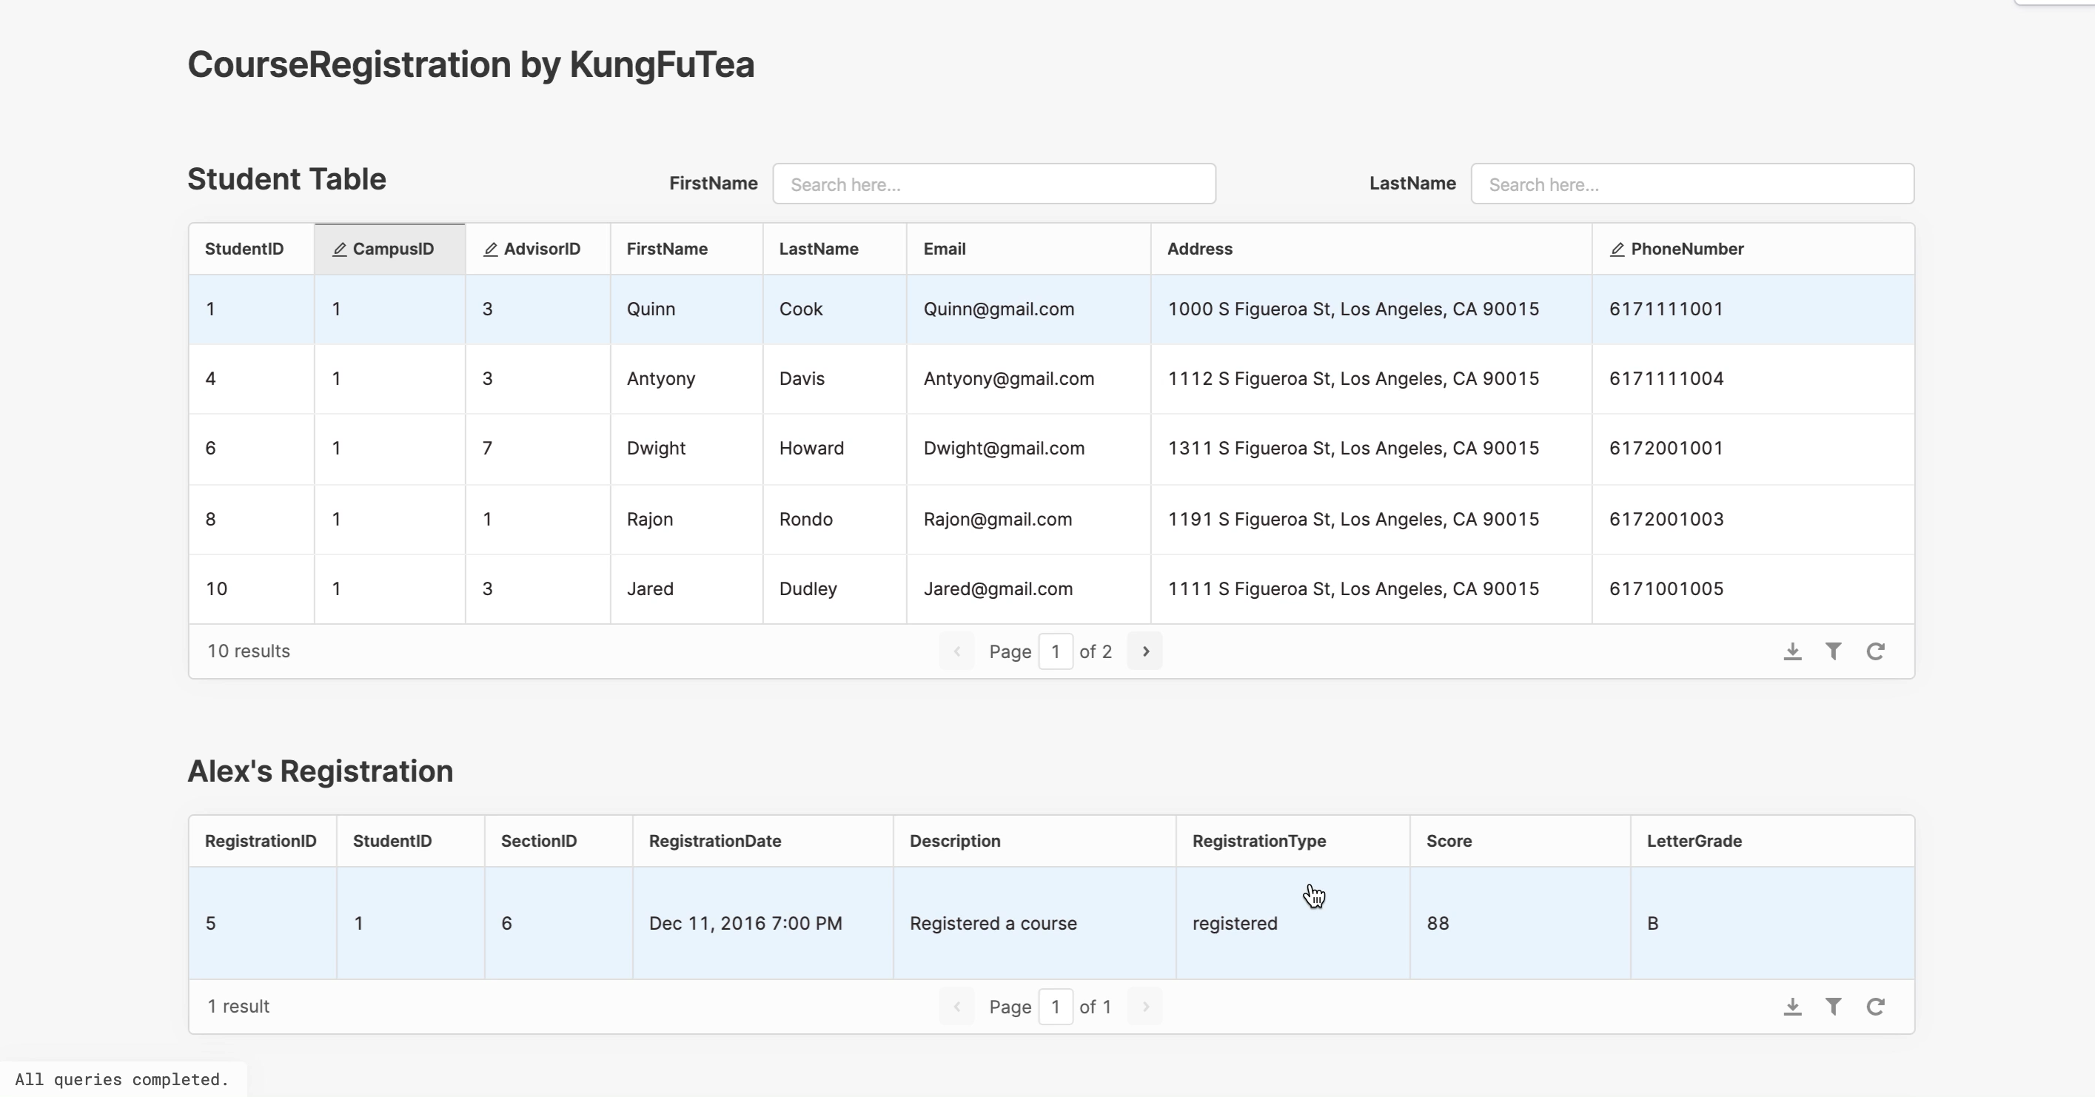
Notes:
https://drive.google.com/open?id=1o_uH-4PGMnHsdJcgCRD9L5C7aWTy2Qvm

Slide 19

Thank you

